Slide 1



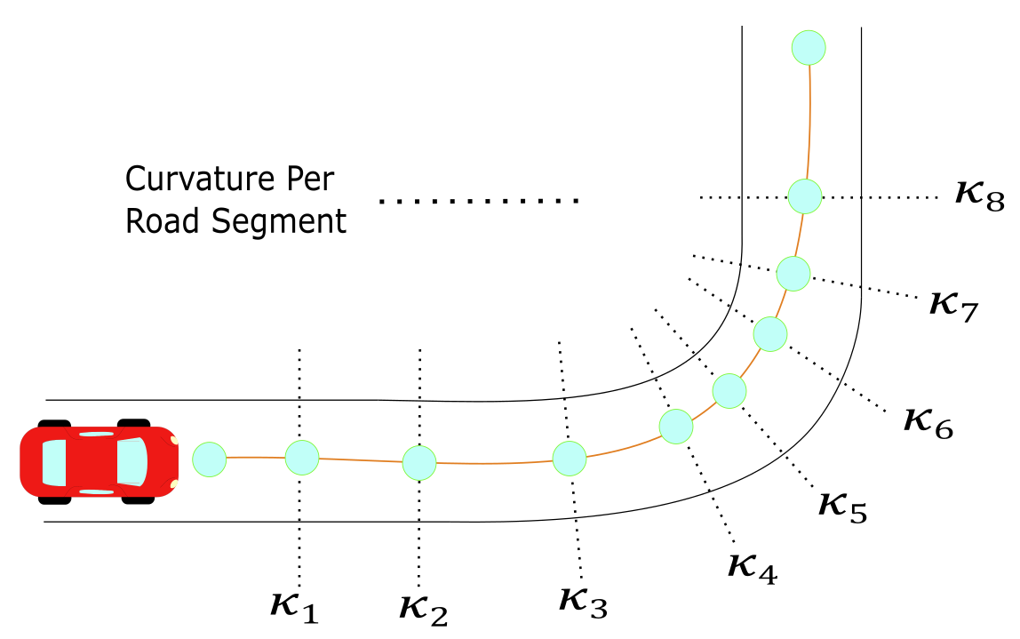
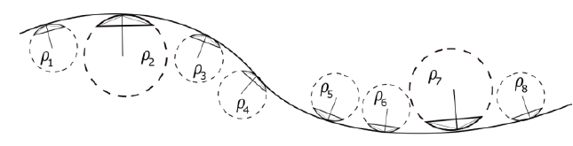
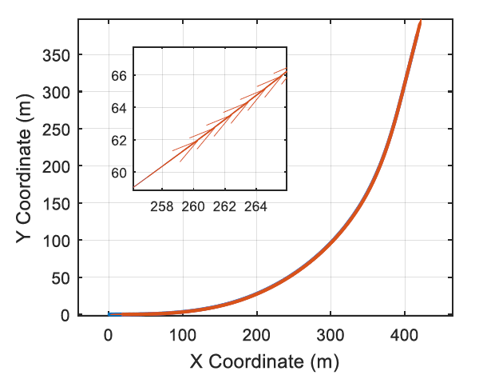
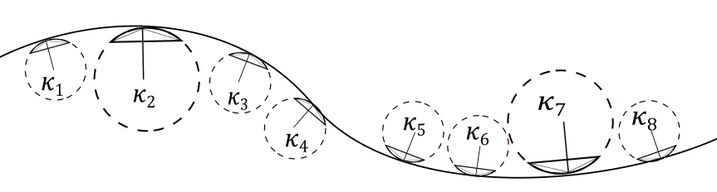
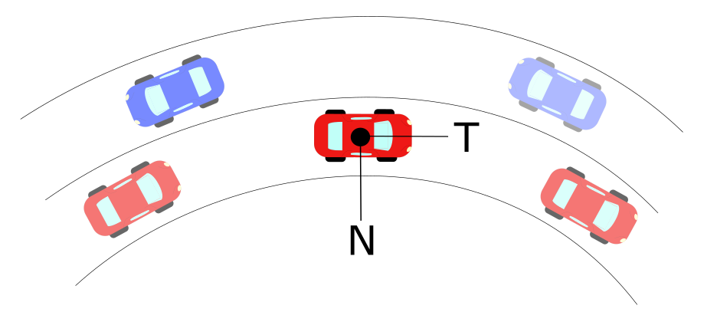
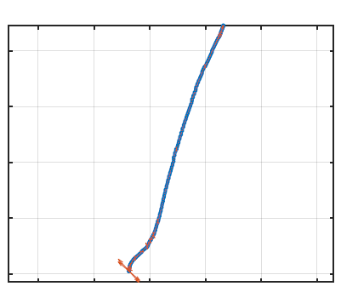
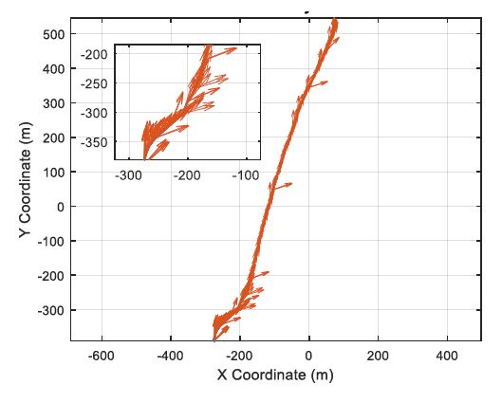
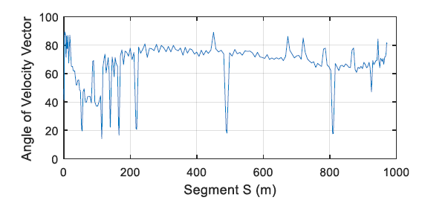
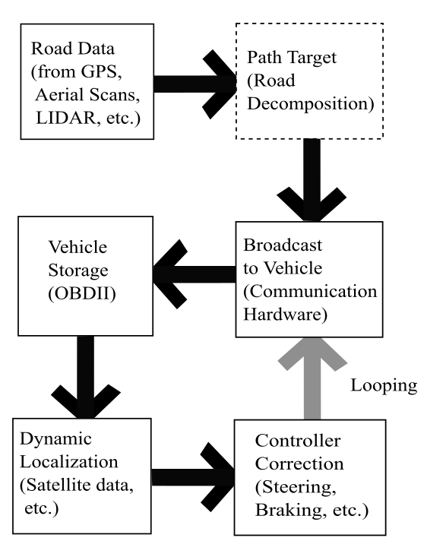
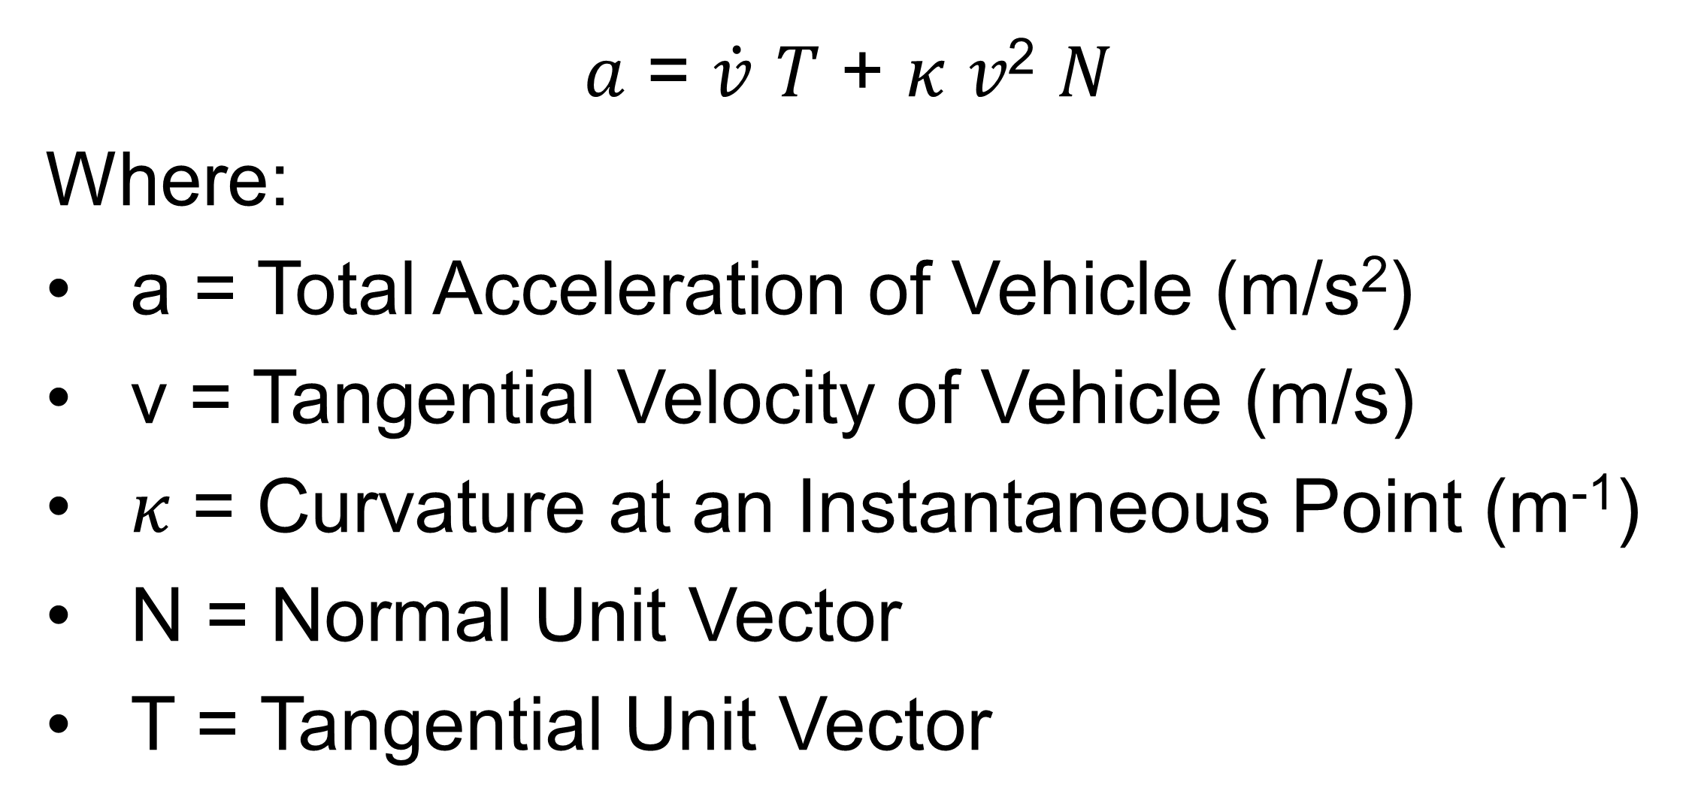
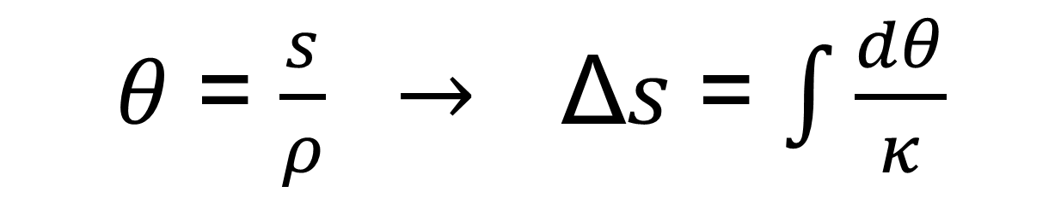
Road Curvature Decomposition for Autonomous Guidance
Ricardo Jacome, Mechanical Engineering Graduate Research Assistant, University of Nebraska -Lincoln
Jacome, Sweigard, Stolle
OBJECTIVE
METHOD FORMULATION
MODEL IMPLEMENTATION
Develop a method for discretizing geospatial data and providing path guidance for autonomous vehicles.
By obtaining a discretized version of the road with data such as GPS points, or Satellite Maps, it is possible to obtain a representation of the road that can be matched to the analytical road that AASHTO provides.
This representation is obtained using curvature data. As per road design, certain levels of acceleration and curvature are needed as shown in the image below. These curvatures can be shifted orthogonally to obtain a heading angle of travel.
The next graphs illustrates the results from the three road models. From left to right, the first graph shows horizontal and vertical coordinates of a road with curvature vectors along each discrete point. The second graph shows the same road with now heading vectors which denote the direction of the vehicle as it goes through the road.
The third and fourth graphs denote the curvature and heading angle of the vehicle as functions of the segment length. Except for the GPS Model that does not show the curvature graph.
BACKGROUND
Vehicle autonomy has been touted as the future of transportation, but there are significant challenges which remain to be addressed.
Tremendous growth has been achieved in “Advanced Driver Assistance Systems (ADAS)”.
ADAS systems rely on sensors for operations, which are susceptible to weather disruptions and poor road conditions.
Road Curvature Decomposition was designed for achieving a new level of guidance to autonomous vehicles which depends on AASHTO road design standards.
AASHTO Base Model
300
250
200
150
100
50
300
250
200
150
100
50
0 100 200 300 400
0 100 200 300 400
Examples of Road with Discretized Curvatures and Radius of Curvatures (left image) and top view of road with vehicle going through the “sliced” road (right image).
Google Earth Model
METHOD FORMULATION
x10⁶
4.5465
4.5460
4.5455
4.5450
x10⁶
4.5465
4.5460
4.5455
4.5450
AASHTO guidelines uses acceleration on normal-tangential coordinates for calculating maximum levels of friction available per road segment.
The acceleration definitions is provided below:
This method provides a heading angle, that can be related to the segment length and curvature through the formula provided below:
7.265 7.27 7.275 7.28 7.285 x10⁵
7.265 7.27 7.275 7.28 7.285 x10⁵
𝜃 = $\frac{s}{ρ} →$Δ𝑠 = $\int{\frac{dθ}{κ}}$
GPS Model
The method is tested by first generating a base model obtained from the AASHTO guidelines of design. Then, two models are generated from selecting google maps’ data points, and GPS data collection. These models are shown in the model implementation section.
400
200
0
-200
-400
500
400
300
200
100
0
-100
-200
-300
-800 -400 -200 0 200 400
-800 -400 -200 0 200 400
*Where x-axis denotes Horizontal Coordinates and y-axis denotes Vertical Coordinates
Normal-Tangential Coordinates Example in Vehicle’s Center of Mass
In order to implement the method into a full autonomous vehicle scheme, the following diagram on the right shows an overview of how data flow is used during autonomous navigation.
The objective of the method is to be part of a Vehicle to Infrastructure scheme for future DOT implementation.
CONCLUSIONS & FUTURE WORK
𝑎 = $\dot{v}$ 𝑇 + 𝜅 𝑣² 𝑁
Where:
a = Total Acceleration of Vehicle (m/s²)
v = Tangential Velocity of Vehicle (m/s)
𝜅 = Curvature at an Instantaneous Point (m⁻¹)
N = Normal Unit Vector
T = Tangential Unit Vector
A method was proposed to calculate trajectories based on discrete curvature and road tangent calculations. The proposed method is consistent with AASHTO design guidelines and can be made to be compatible with vehicle performance limits by controlling allowable speed based on geospatial road curvature.
Successful implementation of this method could offer a new key piece to solve the autonomous vehicle paradigm under weather disruptions and/or other navigation technologies.
At each segment of the road, a curvature can be calculated.
ACKNOWLEDGMENTS: Midwest Roadside Safety Facility and Mid-America Transportation Center for funding this research.

